Slide 1
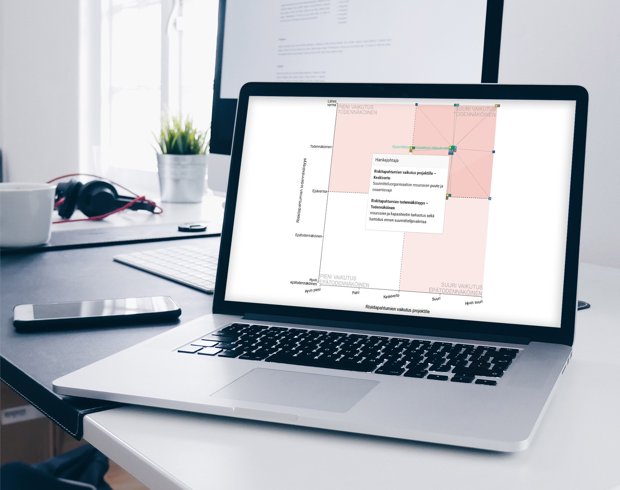
Project risk management process
support@inclus.com
01/2022
www.inclus.com

Slide 2
Risk management process overview
Monitoring risks and mitigation measures
RISK PROCESS OWNER
Risk analysis and determining mitigation measures
Recommended workshop
Planning risk management context
Risk identification
Optional workshop
Risk assessment
Optional workshop
Comprehensive risk situational picture
Defining the process in Inclus
Risk identification
Automatized Inclus session
Risk assessment
Automatized Inclus session
Result visualizations and Task Manager
INCLUS SOFTWARE
Risk data flow

Slide 3
User management and process setup

Slide 4
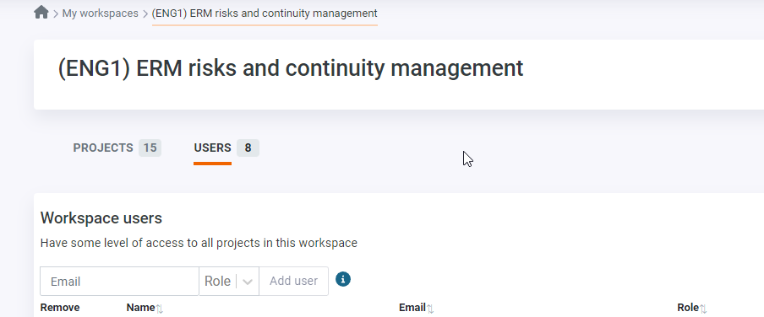
User management
Login
You will get invited to use inclus via email
You will be asked to create a password before accessing the workspace
Your User ID is your email address
Adding user rights
Admins can add different levels of user rights for the workspace (admin/user/reporter/viewer)
Screenshot from the Users page

Slide 5
Adding risk list (risk process owner)
From the Items tab it is simple to create a risk list
The risk process owner can define which risks are active in different sessions by clicking the  symbol to deactivate certain risk items
New risks can be added from excel or manually from the button:”Add new item”
Example risk list on the Items tab

Slide 6
Setting the risk assessment criteria
The risk owner determines suitable risk assessment criterias and settings in the Criteria tab
Risks are often evaluated based on likelihood and impact
Reach out to our customer success team if you are interested in using aggregate criterias, for example to calculate the total impact of risks
Example assessment criterias on the Criteria tab

Slide 7
Setting background groups
In the Groups tab, the risk process owner can define background group options for the participants. This is allows analyzing the results based on group
You can add ready made groups based on function, unit, role or something else
Example background groups on the Groups tab

Slide 8
Inclusive risk identification and assessment

Slide 9
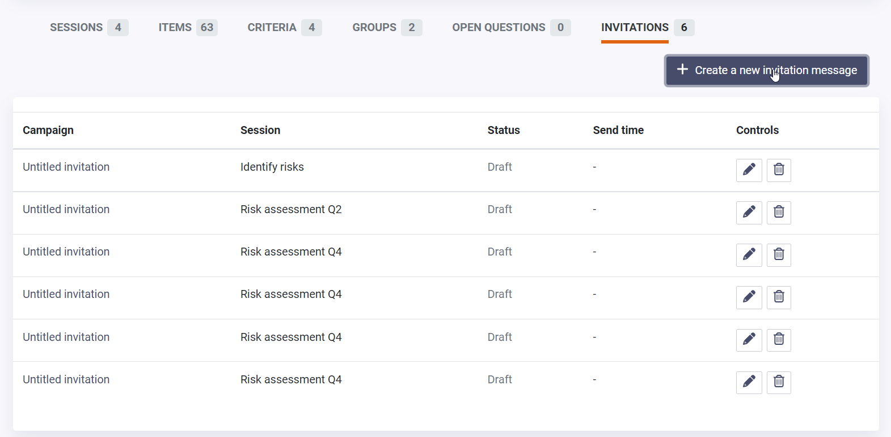
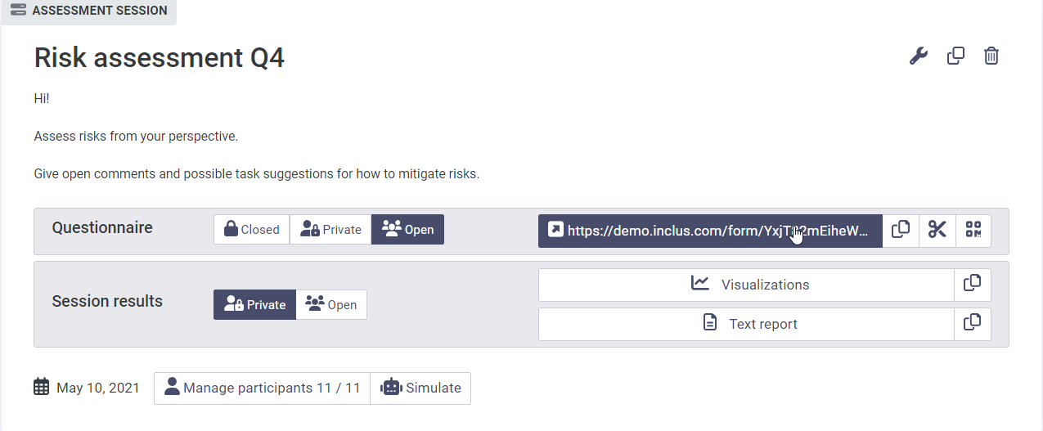
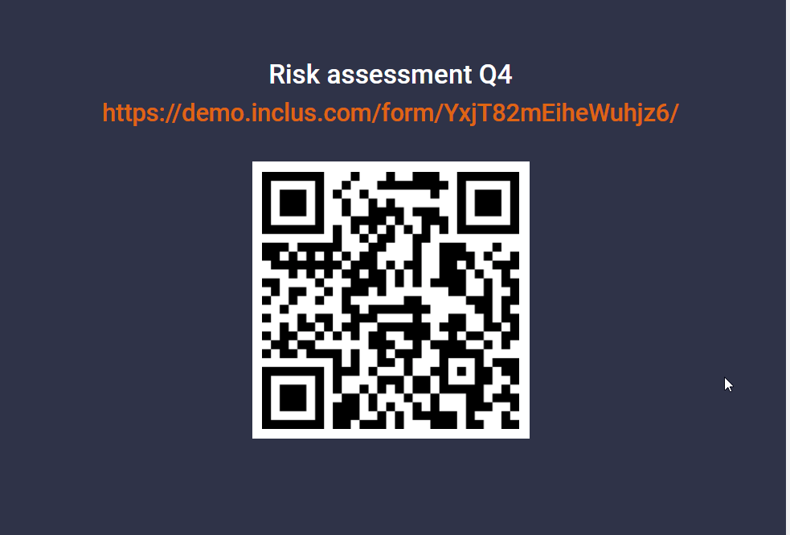
Sending the questionnaire link to participants
Questionnaire invitations can be sent directly from Inclus from the Invitations tab
You can also copy and share a direct url or QR code to the session
Screenshot from the Invitations tab
Copying session URL on the Sessions tab
Example QR code of session URL

Slide 10
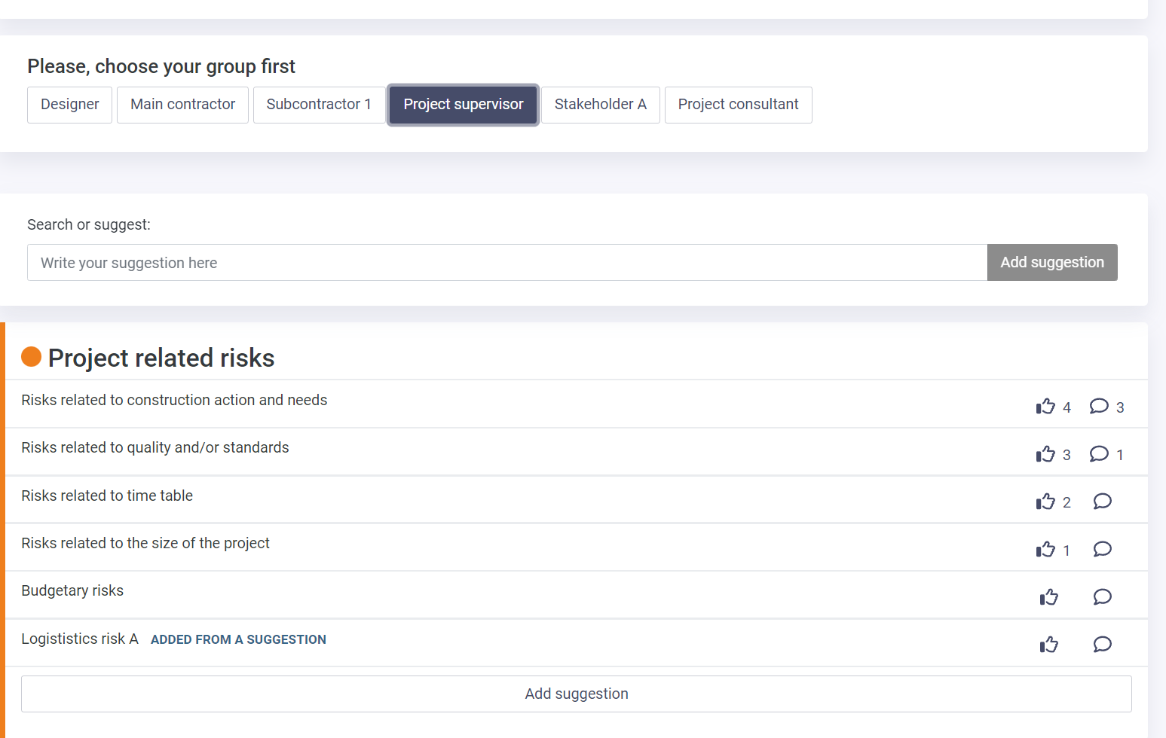
Inclusive risk identification
In the risk identification phase you can engage different units and functions to identify risks from their operation point of view
Participants can add new risk suggestions under the defined risk categories
Participants can share their thoughts via the comment bubble icon
Risks can be prioritized by flagging or giving thumbs up – indicating that the risk should be assessed more thoroughly
The risk process owner gets a comprehensive view of relevant risks to assess further in the next phase
Example identification session

Slide 11
Risk suggestion approval and editing
After the risk identification round, the risk process owner can go through received suggestions and comments
Risk owner is able to activate or deactivate the most relevant risks to be included in the risk assessment
Risk process owner view of viewing risk suggestions

Slide 12
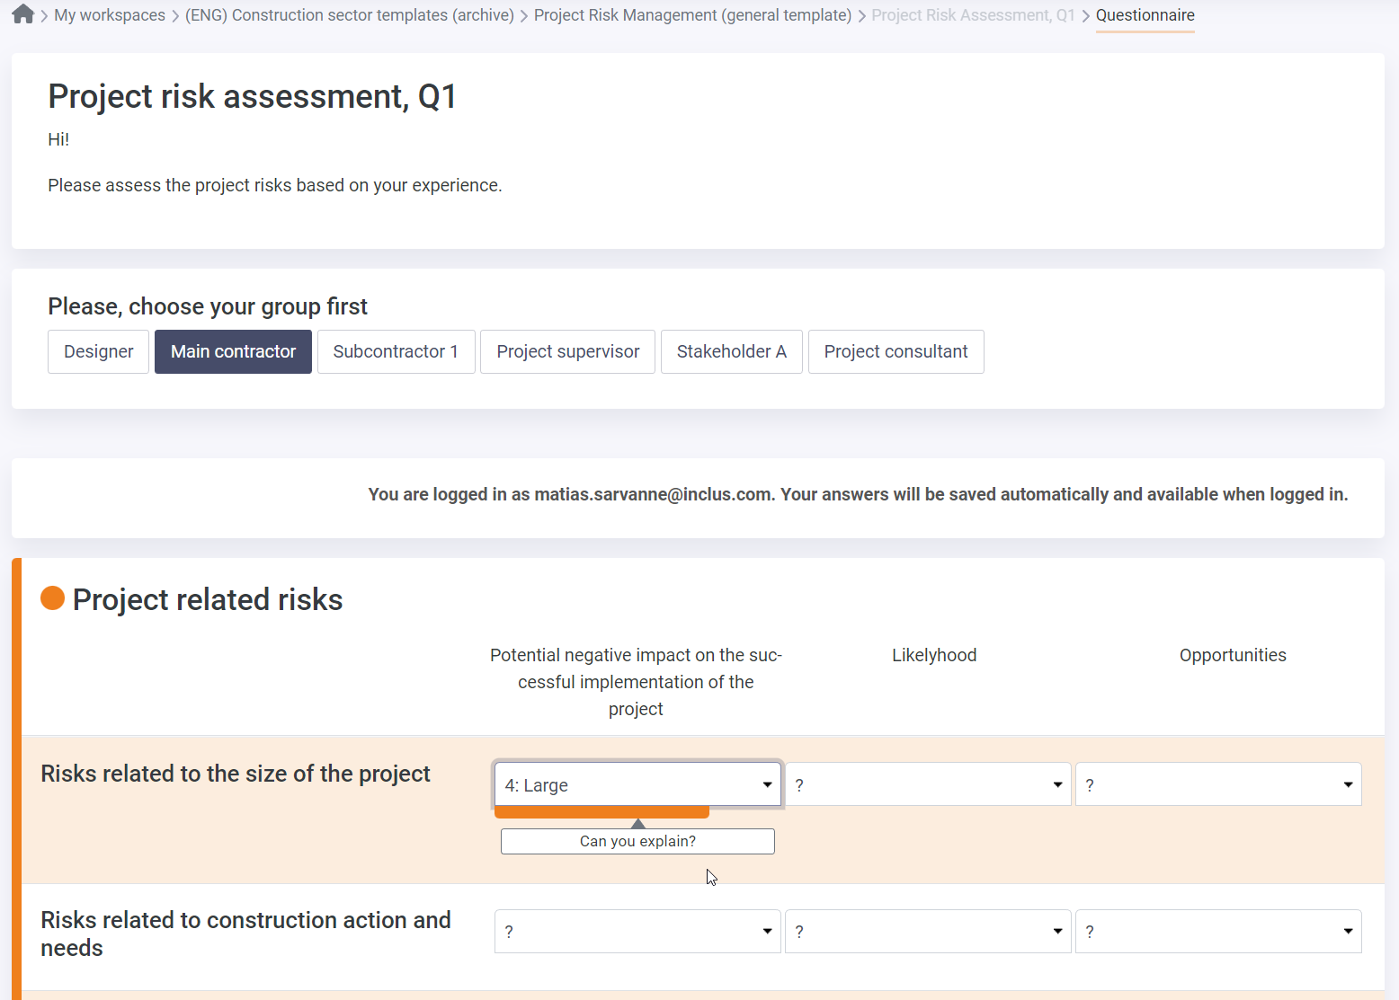
Inclusive risk assessment
When the risk identification round is completed it is time for the risk assessment phase
Risk items can be assessed for example based on likelihood, impact, opportunities or cost impact. This is determined on the Criteria tab
Participants assess the included risks by giving numerical value for each criteria
Comments and mitigation measure suggestions are also collected depending on the assessment criteria setup
Example risk assessment session

Slide 13
Risk results analysis and action planning

Slide 14
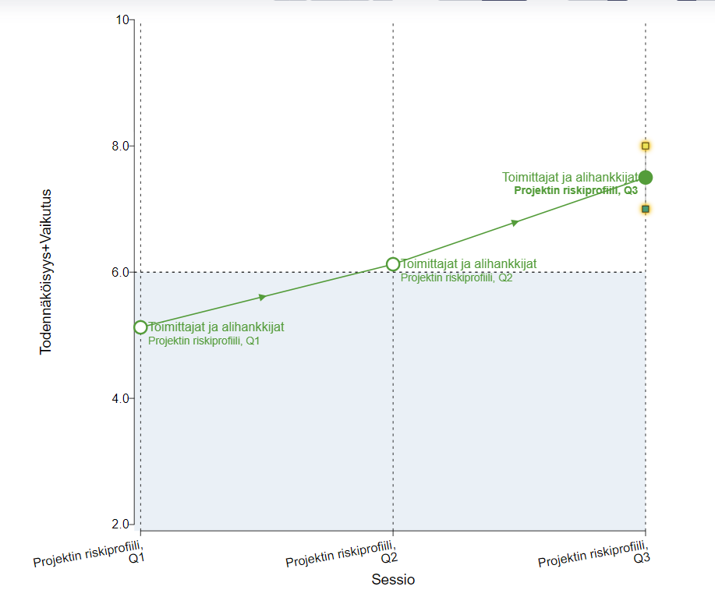
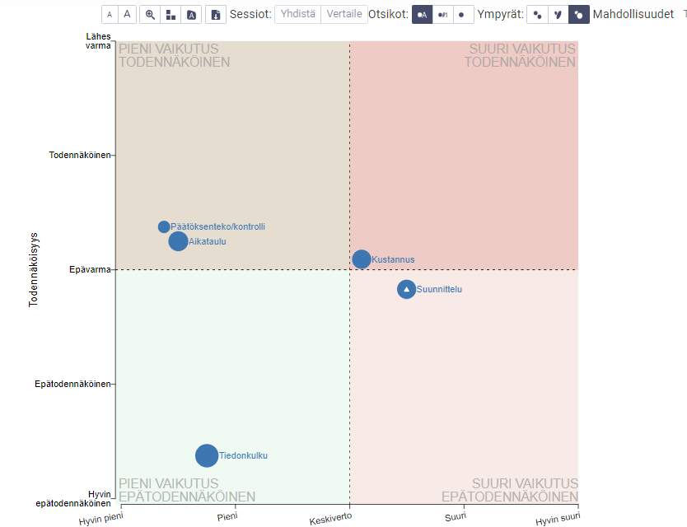
Project risk assessment results and situational picture
Risk process owner gets a comprehensive risk situational picture from the visualisation page
Scatter plot can be modified choosing different criteria for the x- and y-axis. Criteria can be combined by sum or multiplication
Risk development over time is possible to follow comparing data from different assessment sessions, for example Q1 and Q2 comparison
Risk situation can be followed through aggregate criteria and one criteria for example could total impact of the risk
Example visualization of monitoring risk development
Example visualization showing relevant risks on a scatter plot

Slide 15
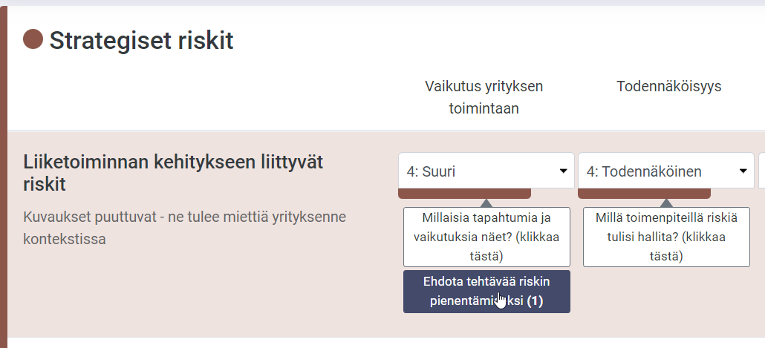
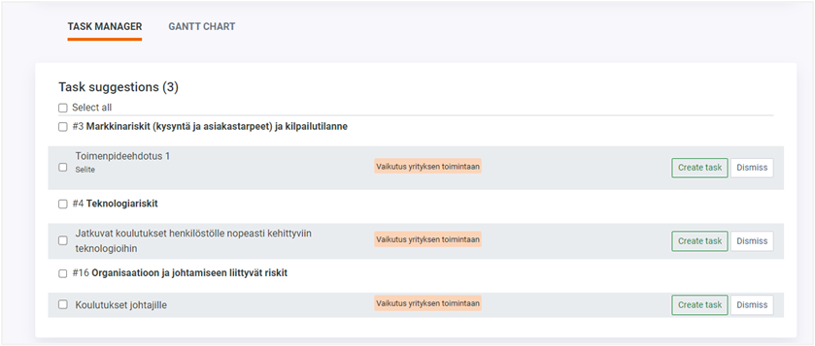
Adding and managing risk mitigation measures
Participants can add concrete task suggestions for risk mitigation directly on the assessment form
When and where the task suggestions are asked is defined in the criteria setup
After the risk assessment, the risk process owner can see all task suggestions in the Task Manager
The risk process owner can then create or dismiss the suggestion. If dismissed, the suggestion is archived
Task suggestions
Example assessment that gathers task suggestions
Managing task suggestions in the Task Manager view

Slide 16
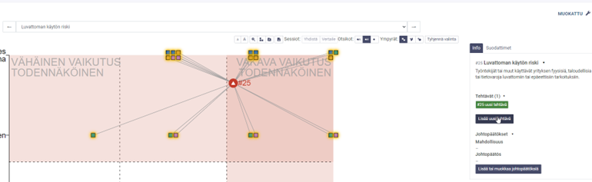
Adding tasks from visualizations and task filtering
Filtering tasks in task manager
In the task manager you can be filter tasks via risk items, tasks, responsible persons, deadline and status
Admin users can see the whole list and can filter the view by these filters.
Users see only tasks that are assigned to them
Adding tasks from the scatter plot
Users can add tasks from the scatter plot by clicking the risk item dot and add tasks or conclusions from the info on the right
Filtering tasks in the Task Manager
Adding tasks on the visualizations page
Notes:
Risk/item owners

Slide 17
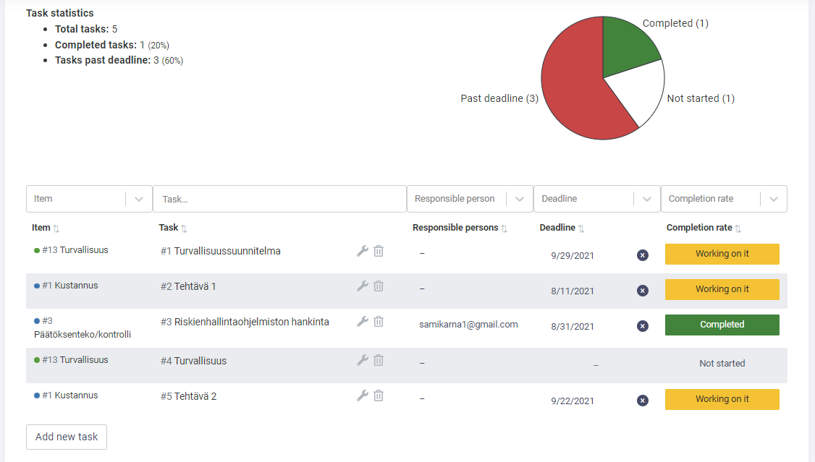
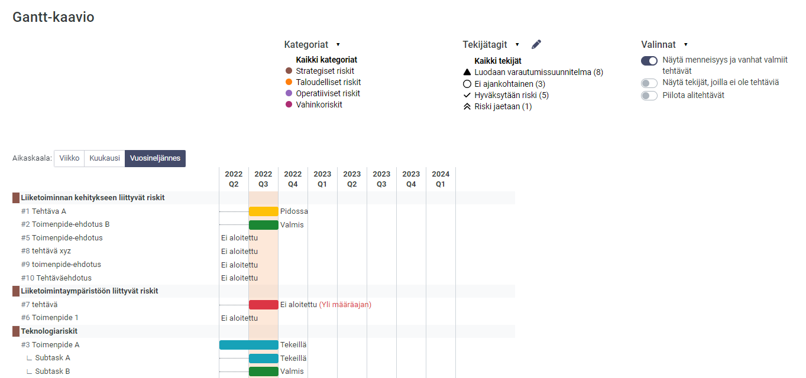
Adding and controlling the tasks from the task manager
After the risk assessment, risk process owner(s) can add tasks to control and mitigate risks
Add new task
Connect the task to a certain risk item
Define responsible person, starting date and deadline
GANTT chart
View and monitor tasks on a visual gantt chart
Filter the view by category or possible tags
Hide or show old and completed tasks
Modify tasks by clicking the task name
Task Manager view
Task Manager GANTT chart view
Notes:
Tänne toimenpide-ehdotukset (ja GANTT)

Slide 18
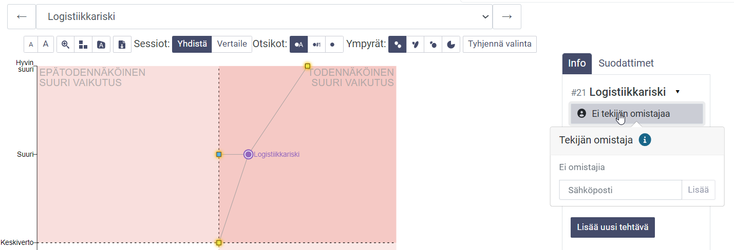
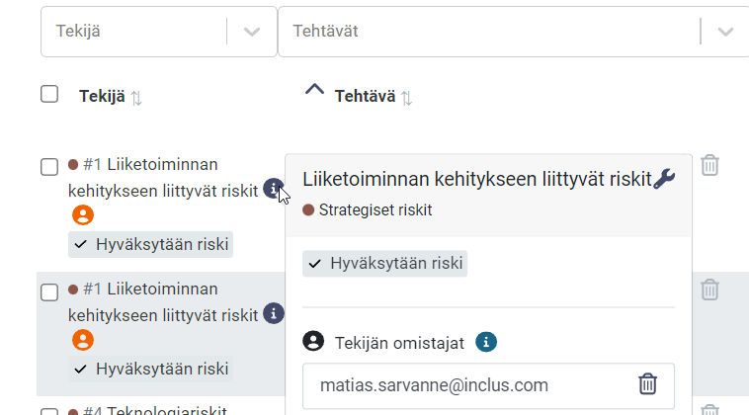
Adding risk item owner
Risk item owners
You can add risk item owners for certain risks to increase the ownership of risks in different organization levels
The risk item owner can be added from the risk item tab, visualizations page and the task manager
Risk item owner gets email notifications about tasks that are linked to owned risks
Adding risk owner in Item list
Adding risk owner in Visualizations
Adding risk owner in the Task Manager
Notes:
Risk/item owners

Slide 19
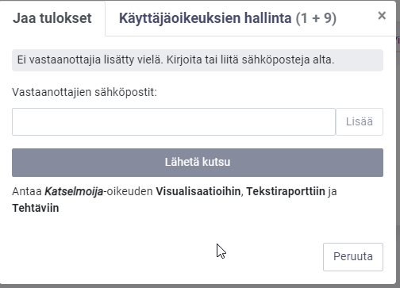
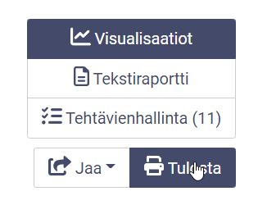
Reporting the situational picture
The results view can be shared through a link sent via email
The active results view can easily be printed as a PDF
A link to the visualizations page and Task Manager can be shared via email
Sharing the results view
PDF Print button
Sharing the results view
Notes:
PRINT PDF

Slide 20
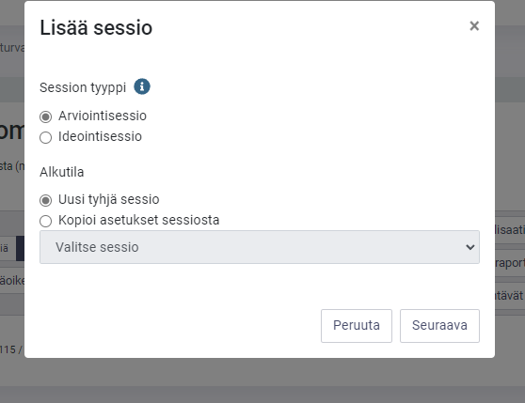
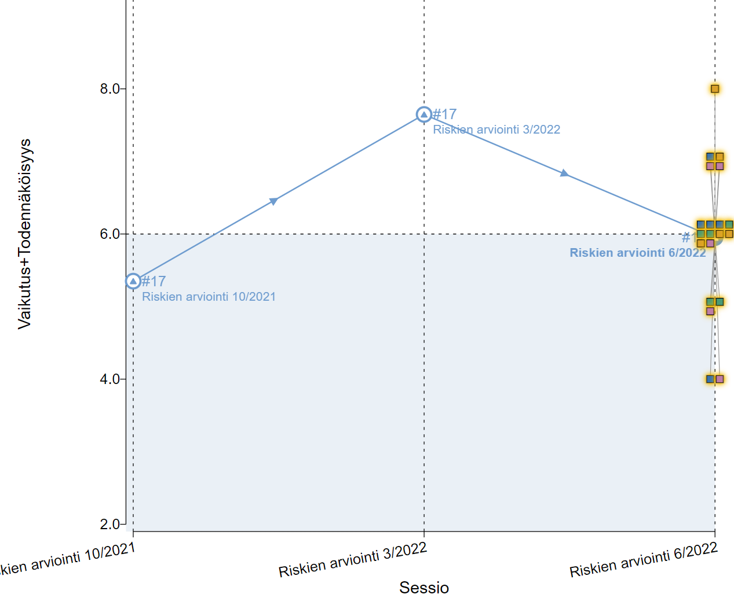
Continuous risk assessment
Risk assessments can be repeated by adding a new session to the project
Choosing the session type depending the needs:
Is there are need for identify new risks → risk identification session
Is there a need to assess the development of existing risks → assessment session
Creating a new assessment
Simple monitoring of risk development through the scatter plot
Monitoring risk development

Slide 21
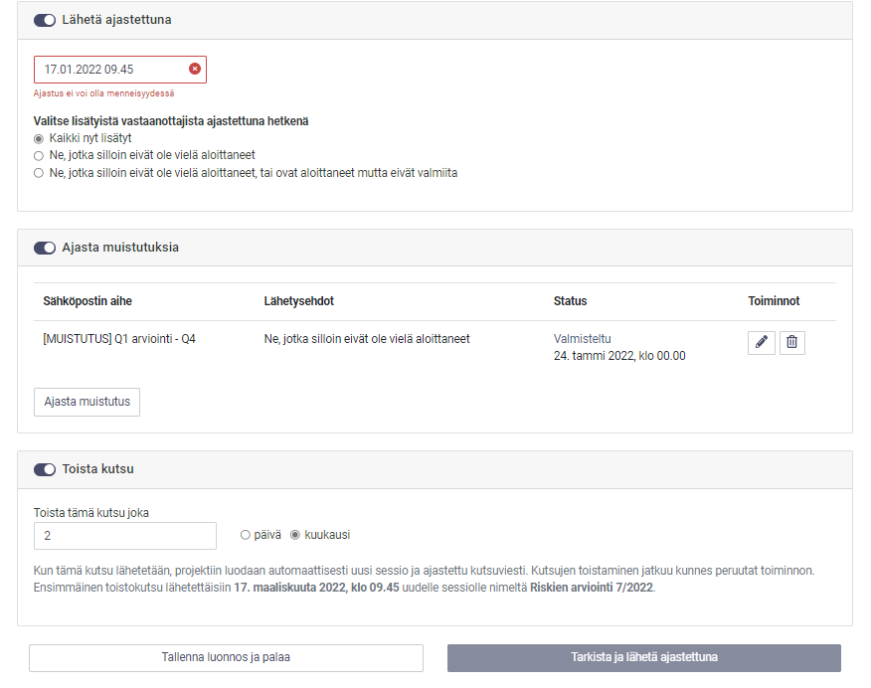
Automatized risk identification and assessment
Risk identification and assessment invitation can be automated on the invitations tab
Manage your session invitations on the Invitations tab
Invitations and reminders for online assessments can be made beforehand and scheduled
Invitations can be repeated for example monthly or quarterly – creating new sessions automatically
Setup recurring sessions and invites

Slide 22
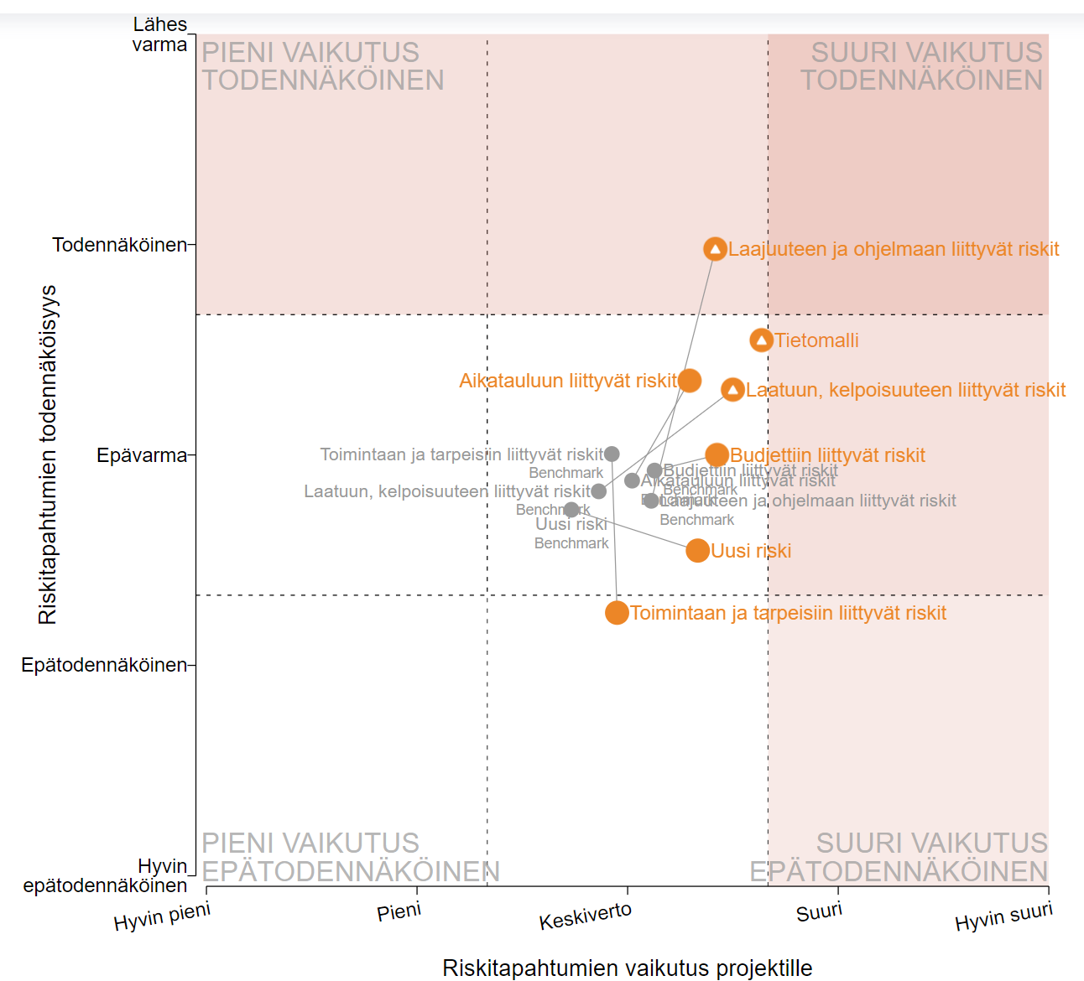
Project portfolio management/Benchmarking
The benchmarking functionality consolidates result data from different projects to the same visualizations page. This enables monitoring the entire project porftolio’s risk management
Reach out to us for more information about benchmarking: support@inclus.com
Example benchmarking view

